Slide 1
Decision Trees

Slide 2
Contents
Introduction to Decision trees.
Theory behind decision tree.
Advantages of decision trees.
Algorithms to select best split.
Disadvantages of decision tree and methods to overcome it.

Slide 3
What are Decision Trees
Decision trees are a type of Supervised learning (which have target variable) models which come under Tree Based Modelling.
Decision trees can be used for both Classification as well as Regression problems.
Unlike traditional machine learning models like Linear Regression and Logistic Regression which define a mathematical equation and predict the target variable using that equation, Decision trees try to generalize the data and try to find out various patterns in the data. So that when we use a new data point, the model tries to match most suitable pattern and gives the output.

Slide 4
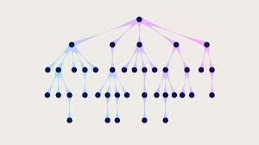
How does it work?
Now that we know what decision tree is, lets see how it works.
As the name suggests, this algorithm creates a tree like structure on the data in such a way that most similar data points are grouped together and assigned to a node.
So that, whenever a new data point comes
in, it tries to match the data to most similar
group and assigns a label to it.

Slide 5
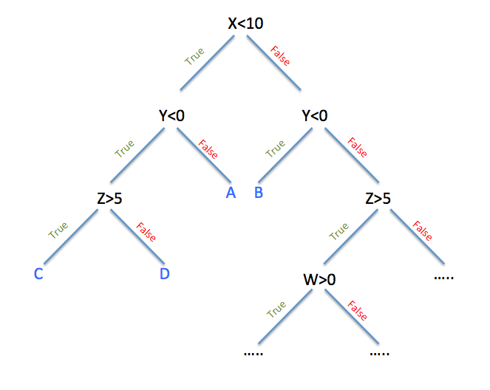
Decision Tree
Here is an example of how a
decision tree looks like.
It goes on making decisions at
each node and assigns a label at
leaf node.

Slide 6
Advantages over traditional models.
Tree based models have many advantages over traditional models like Linear or Logistic regression.
Easy to interpret.
The output of Decision trees are very easy to understand and interpret. There is no need of any previous statistical knowledge to interpret it. Decision trees can be visualized which makes interpretation of the output very easy.

Slide 7
Cont….
Less data cleaning.
Unlike Regression models, decision trees are not sensitive to outliers and missing values to certain extent.
Non linear data can be handled.
One major advantage of decision tree over regression models is, it can handle non linear data very well. In real time it is highly unlikely that the data is linear, in such cases decision trees can be used instead of Regression trees.

Slide 8
Cont….
Both Categorical and Numerical data can be handled.
Decision tree can be used on both numerical and categorical target variable.
Helpful in identifying significant variables.
Decision tree is very helpful in identifying most significant variables which are affecting target variable in our data.

Slide 9
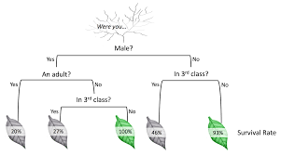
Important Terminologies
Root Node:
It is the first node in a tree. This node is further connected to child nodes.
Decision node:
It is a node where a condition is checked and data flows to further sub-nodes based on the outcome of the decision.
Leaf Node:
Leaf node is the final node on the tree. No further splitting occurs at
this node. This node contains either of the classes of target variable.
Splitting:
It is the process of splitting a decision node to further decision nodes or leaf nodes.

Slide 10
How does splitting happen?
How does decision tree knows:
Which variable to pick as Root node.
How to select split criteria.
If its numerical variable, what is the optimal value to split to further nodes, e.t.c.
Decision tree uses below algorithms to answer above questions.
Gini Index
Information gain
Chi-Square test
Reduction in variance.

Slide 11
Gini Index
Gini Index works with Categorical target variables.
This can be used to perform only binary splits.
Higher the value of Gini Index, Higher the homogeneity.
Steps to calculate Gini Index:
A categorical variable is randomly chosen and split into child nodes.
Gini Index is calculated for each child nodes using the formula:
Gini = p2 + q2

Slide 12
Cont….
Where p = Probability of Success
q = Probability of failure.
3. Calculate weighted Gini index for whole split using Gini scores for each node.
4. This Step is repeated for all categorical variables.
5. And the variable with highest Gini Score is chosen as Root node as it produces nodes with high homogeneity.

Slide 13
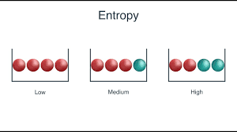
Information Gain
In Information gain, we calculate entropy of each node and select that node with least entropy.
In plane English, Entropy can be defined as measure of homogeneity.
A node with Zero Entropy is highly homogeneous.
A node with One Entropy is highly heterogeneous.
Entropy is calculated by:
Where p is probability of success
q is probability of failure in the node

Slide 14
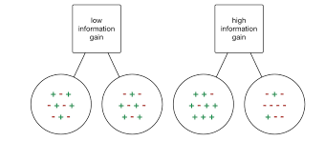
Cont….
Information Gain is then calculated using:
Information gain = 1 – Entropy.
Thus we can conclude that as Entropy goes on increasing, Information gain goes on decreasing.
Thus we will select that split which
produces highest Information gain.

Slide 15
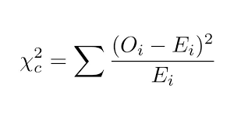
Chi-Square Test
The value of Chi-Square statistical test gives us significance between two variables.
In case of decision tree, we calculate chi-square value between sub node and parent node.
Higher the value of Chi-Square, better the split.
Chi-Square is calculated by:
Where Oi is observed values and Ei is Expected value

Slide 16
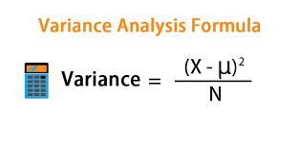
Reduction in Variance
Reduction of Variance is predominantly used when target variable is continuous.
We calculate Variance of each sub node first and then calculate Variance of the split using weighted variance of sub nodes.
Split with minimum variance is selected as best split.
Variance is calculated by: where
x = actual value
µ = mean of all values
N = number of data points.

Slide 17
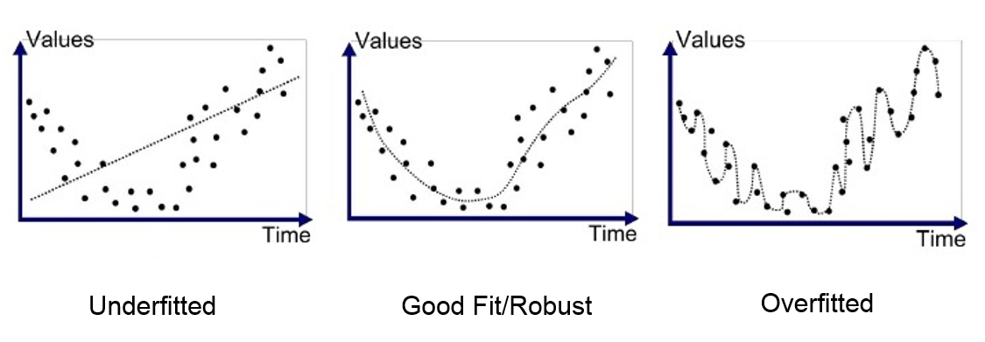
Disadvantages of Decision tree
One major disadvantage of decision tree is Overfitting.
Overfitting in machine learning occurs when the model being trained on the data, learns it too well.
Overfitting happens when our model learns details and noise to such extent that it negatively impacts our results.

Slide 18
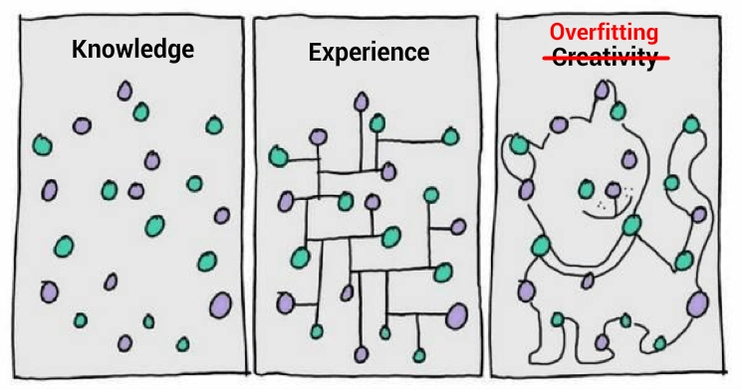
Cont….
Essentially this means, our model is trying to capture noise and random fluctuations as concepts and trying to learn it as a detail in the data.
Problem is these details do not appear in the new data and this negatively impacts models ability to generalize.
Overfitting mainly occurs in non parametric and non linear models like, Decision tree and Random Forest

Slide 19
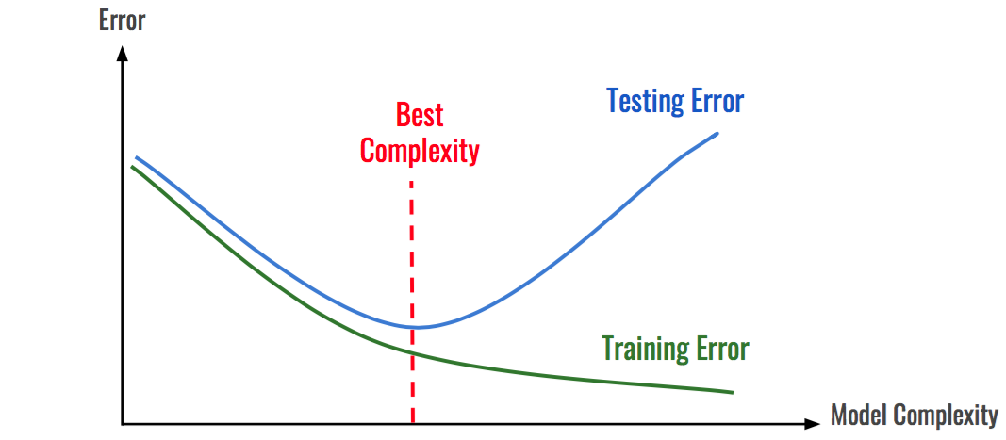
Cont….
You can say your model is Overfit, if it performs too well on training dataset and performs very poorly on the test data set.

Slide 20
How to avoid overfitting
Cross validation:
Cross validation is a process where we keep one small part of the data to test the model and the rest to train the model. We know our model is not overfit, if performance of model is similar for both train and test date.
Pruning
Pruning is especially used when we are dealing with Tree Based models. Here we are simply decreasing the levels of nodes to make the model to learn to generalise the data more.

Slide 21
Cont….
Early Stopping
When training a large dataset, after certain iterations, model will stop generalising and start learning Statistical noise in the dataset. Early stopping will give us this point when to stop training the model.
Regularisation
Regularisation introduces a cost function, which penalises the co efficients in linear models and penalises Weights in neural nets.

Slide 22
Cross Validation
Cross validation is one of the techniques used to avoid overfitting or underfitting.
It involves reserving a part of you data set on which we do not train the model, to test model's performance.
Steps followed for cross validation:
Reserve a part of your data set, i.e. split your data set to train and test set.
Train you model on train data set.
Use test data set as validation set to measure performance of your model.

Slide 23
Common methods used for Cross Validation
Validation set approach.
Reserve 50% test data set and train on remaining data.
Leave One Out Cross Validation (LOOCV)
Reserve only one data point and train model on remaining. This process is iterated for each data point.
K-Fold Cross Validation
Split the data set to certain number of parts, reserve one part as validation set and train on remaining set. Repeat this step for each of the data set.

Slide 24
Regularization
Over fitting happens because our model tries too hard to capture noise in our data. This makes the model more complex.
In trying to achieve so, it assigns more weights or coefficients to some of the features.
Regularisation tries to shrink the coefficients towards zero.
In other words it discourages learning more complex model.
Types of Regularisations:
L1 Regularisation – Lasso Regression
L2 Regularisation – Ridge Regression

Slide 25


L2 Regularization – Ridge
For a linear regression equation, fitting procedure involves a loss
function, Residual Sum of Squared Errore(RSS). The co efficients are chosen in such a way that they reduce this loss function.
In Ridge regression we introduce a penalty in our loss function.
Here Lambda is our tuning parameter.
As we increase the value of Lambda, the magnitude of co efficients decresases.
The value might reach close to zero but never absolute zero.
Ridge regression shrinks the parameters, therefore we use this method to overcome multicollinearity.
It helps in reducing model complexity, hence overcoming overfitting

Slide 26

L1 Regularization – Lasso
Lasso regularization is different from Ridge in that it uses
modulus of β instead of square of β.
And Lambda is the tuning parameter.
Also, as we go on increasing value of Lambda, the coefficients reaches absolute Zero.
Thus, Lasso select only some features, while reducing other coeffcients to zero.
Thus we can also use Lasso regression for feature selection if our data contain a huge number of features.

